Slide 1
Module 7: Lesson 4 NoSQL Database Classifications (Part 1)

Slide 2
NoSQL Database Classification Dimensions
Relational databases derive from a precise approach to modeling data and a standard language to manipulate that data, and as a result most implementations share many common characteristics.
But NoSQL databases were created to meet the specific needs of the organizations which created them with few common theoretical underpinnings and using non-standard data query and manipulation languages
Superficially each NoSQL database differs profoundly from the next which makes generalizations difficult, but we can effectively organize our knowledge about NoSQL databases across two dimensions
1. The way they model data
2. Their behavior in the face of failure conditions

Slide 3
NoSQL Data Models
The most common differentiator among NoSQL databases is the way they model, store and allow access to data
Each NoSQL database can be categorized as aligning with one of four possible data models
Key-value store
Document store
Column store
Graph store
NoSQL databases are diverse and some support combinations of the above models or even additional ones such as time-series representations

Slide 4
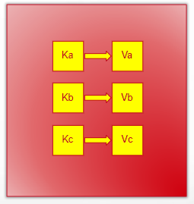
NoSQL Data Models – Key-Value Store
Each database item is stored as a unique key together with an associated value.
Optimize for fast retrievals and high scalability due to the simple key-based lookup mechanism.
Usually the application is aware of the value content and format and not the database
Ideal for applications requiring frequent lookups with predictable and simple access patterns.
Examples: Redis, DynamoDB, Riak, memcached

Slide 5
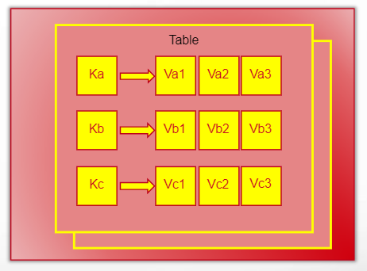
NoSQL Data Models – Column Store
Each database item is associated with a unique key and stored in a table with rows, and columns.
Usually the database is aware of the row and column format of each item
Often excels at performing row level filtering and column aggregations (sum, average, etc.)
Efficient for analytics workloads involving large datasets using a rich query language
Examples: Apache Cassandra, Google BigTable

Slide 6
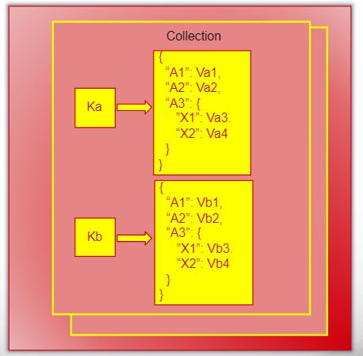
NoSQL Data Models – Document Store
Document databases store data in documents similar to JSON (JavaScript Object Notation) objects.
JSON is a standard text-based format for representing structured data based on JavaScript object syntax.
Each document (JSON object) is a sequence of attribute-value pairs associated with a unique key
Attributes are strings and values can be strings, numbers, Booleans, arrays, objects, or null.
So documents supports hierarchical data structures, which enables complex data relationships

Slide 7
NoSQL Data Models – Document Store
Unlike relational databases with predefined structures, documents can have a flexible schema.
Fields and their types can vary between documents within a collection.
A natural fit for storing unstructured data like emails, or social media posts, or sensor readings, where the data format might not be entirely consistent.
Document databases excel at queries that target specific document fields or nested data structures
Examples: MongoDB, Couchbase, CouchDB, AWS DocumentDB

Slide 8
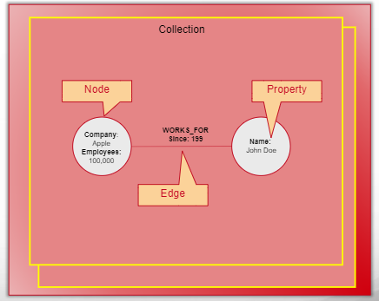
NoSQL Data Models – Graph Store
Data is stored as nodes (entities) and edges (relationships) that connect them. This structure reflects real-world connections between data points.
Similar to document databases, graph databases offer a flexible schema. Nodes can have varying properties, and the relationships between them can evolve without altering the core structure.
Traversing relationships between nodes is incredibly fast. Unlike relational databases that rely on joins, connections are explicitly stored, enabling rapid retrieval of connected data.
The ability to navigate connections between data opens doors for powerful graph-based analytics. You can uncover hidden patterns, identify communities, and perform complex network analysis.
Examples: Neo4J, AWS Neptune

Slide 9
NoSQL Database Model Variety Advantages
Addressing the Data Impedance Mismatch
Data impedance mismatch refers to the challenges that arise when trying to fit an object-oriented program's data structures into a relational database's tables.
Enabling Opportunities for Polyglot Persistence
Polyglot persistence means using multiple data storage technologies within a single application to best suit different data needs.

Slide 10
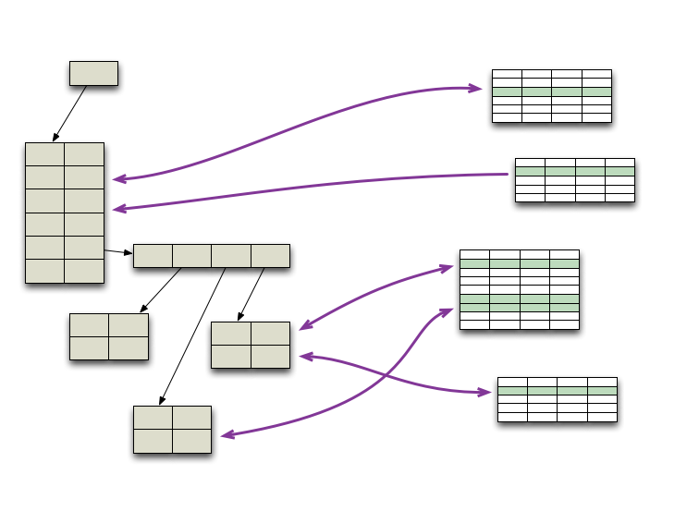
Addressing the Data Impedance Mismatch
Object vs. Table: Relational databases store data in tables with rows and columns, while applications often store data as objects with properties and methods.
Application Data
(Object)
Object Relational
Mapping
Relational Database
(Tables)
This inherent discrepancy creates an impedance mismatch (structural gap), hindering the seamless translation between the two.
Translating between object-oriented structures and relational tables requires extra code or tools (Object-Relational Mapping) which can be cumbersome and error-prone.
Using an ORM can be computationally expensive and so hinder performance, especially when dealing with large datasets
Also, retrieving data involving intricate relationships necessitates complex JOIN operations in queries, causing further performance bottlenecks.

Slide 11
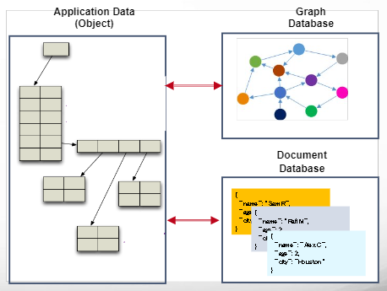
Addressing the Data Impedance Mismatch
NoSQL databases offer various data structures (documents, graphs) that can better represent complex object relationships, reducing the need for extensive mapping.
Document stores: Documents closely resemble objects, encapsulating data within a single unit, fostering a more natural mapping between application data and database storage.
Graph databases: Relationships between data entities are explicitly
modeled using graph structures, effectively mirroring the interconnected nature of objects within an application.
But due to lacking joins, data elements might be duplicated across multiple records potentially causing inconsistencies in data integrity

Slide 12
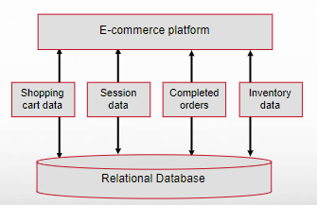
Enabling Opportunities for Polyglot Persistence
Enterprises tend to use the same database engine to store business transactions, session management data, and for other storage needs
And this is usually some form of relational database management system

Slide 13
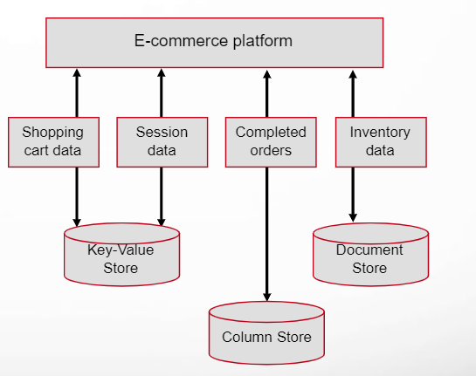
Enabling Opportunities for Polyglot Persistence
Polyglot persistence allows developers to select the most suitable data storage technology for each specific use case or data type, rather than relying on a single, monolithic database system.
That is, the specialized data models associated with different areas of application functionality each may be more efficiently represented and queried using distinct data storage technologies.
For example, relational databases may be optimal for structured data with complex relationships, while NoSQL databases may excel at handling unstructured or semi-structured data with flexible schemas.
By leveraging polyglot persistence, organizations can achieve enhanced programming simplicity and better performance in managing their data.
They can choose each data storage technology independently, allocating resources according to the specific needs of each data model, rather than relying on a one-size-fits-all approach.

